Slide 1


Bank Marketing Machine Learning Model
Data-Driven Approach for Campaign Optimization
Kunal Hire 25/11/2023

Slide 2
Introduction and Objective
Introduction:
Telemarketing is a pivotal strategy for customer engagement, and our project focuses on refining this process through advanced analytics and predictive modeling.
This initiative stems from a comprehensive analysis of the bank's telemarketing practices, aiming to address existing challenges and enhance overall campaign efficiency.
Objective: The objective of this project is to increase the effectiveness of the bank's telemarketing campaign by developing a more granular understanding of the customer base, predicting customer responses to telemarketing efforts, and establishing a target customer profile for future marketing plans. Specifically, the project aims to:
Predict whether a bank client will subscribe to a term deposit based on various customer features, such as demographics and transaction history.
Identify which types of customers are more likely to make term deposits.
Optimize marketing efforts by focusing on the target customer profile.
Improve customer satisfaction by reducing undesirable advertisements for certain customers.
Key Focus Areas:
Customer Targeting: Precision in identifying customers with a higher likelihood of subscription.
Resource Allocation: Optimizing the allocation of marketing resources to improve cost-effectiveness.
Enhanced Customer Interaction: Utilizing data insights to enhance the overall customer experience during telemarketing calls.

Slide 3
Business Challenge
Problem Statement:
The bank faces challenges in its telemarketing campaigns, marked by low subscription rates and inefficient resource utilization.
The existing approach lacks precision in customer targeting, resulting in a high number of unproductive calls and increased operational costs.
Business Challenge:
Inefficiencies in the telemarketing process lead to a suboptimal allocation of resources, impacting the overall success of subscription campaigns.
There is a need to enhance customer targeting to increase the likelihood of subscription, reduce operational costs, and improve the customer experience during telemarketing interactions.
Challenges Identified:
Low Subscription Rates: The current model results in lower-than-desired subscription rates, indicating a need for improved customer targeting.
Resource Inefficiency: Inefficient resource allocation leads to a high number of calls with low conversion rates, increasing operational costs.
Customer Experience: The lack of personalized targeting affects the overall customer experience during telemarketing calls.
Impact on Business:
Reduced ROI on telemarketing investments due to low subscription rates.
Increased operational costs and resource wastage.
Potential negative impact on customer satisfaction and loyalty.
Our Approach:
By implementing advanced analytics and machine learning, we aim to address these challenges systematically and revolutionize the telemarketing strategy for enhanced business outcomes.

Slide 4
Dataset Overview
Data Fields:
Age (Numeric): Age of the bank client.
Job (Categorical): Type of job held by the client.
Marital (Categorical): Marital status of the client.
Education (Categorical): Educational background of the client.
Default (Binary): Indicates whether the client has credit in default (yes/no).
Balance (Numeric): Average yearly balance in euros.
Housing (Binary): Specifies whether the client has a housing loan (yes/no).
Loan (Binary): Indicates whether the client has a personal loan (yes/no).
Contact (Categorical): Type of contact communication used in the campaign.
Day (Numeric): Last contact day of the month.
Month (Categorical): Last contact month of the year.
Duration (Numeric): Duration of the last contact in seconds.
Campaign (Numeric): Number of contacts performed during this campaign for the client.
Pdays (Numeric): Number of days that passed since the client was last contacted from a previous campaign (-1 means the client was not previously contacted).
Previous (Numeric): Number of contacts performed before this campaign for the client.
Poutcome (Categorical): Outcome of the previous marketing campaign.
Missing Attribute Values:
No missing attribute values, streamlining the preprocessing phase.
Datasets Used:
Main Dataset: "bank-full.csv"
Alternative Dataset: "bank.csv"
Dataset Size and Temporal Range:
"bank-full.csv":
Instances: 45,211
Timeline: May 2008 to November 2010
Chronological Order
Columns: 16 Variable Cat – 6 Variable Num – 10 Variable

Slide 5
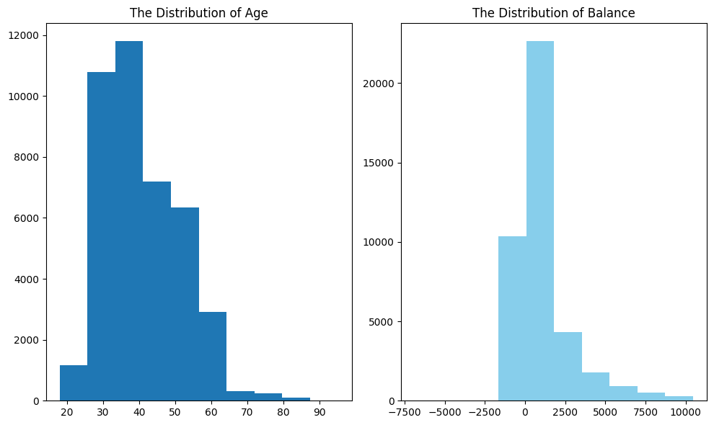
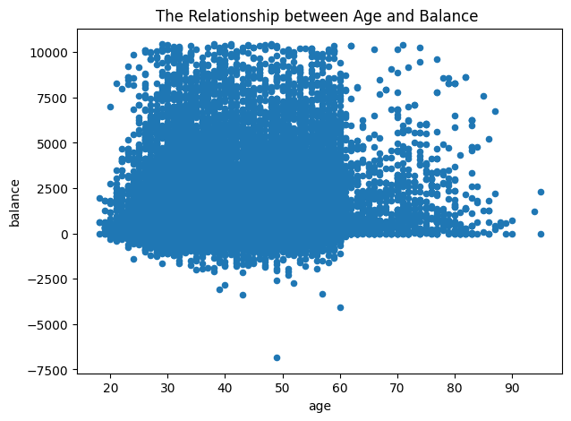
Explotory Data analysis (EDA)
Data Distribution and Relationships:
A. Age and Balance Distribution:
Age Distribution:
Broad age range (18 to 95 years) with a majority in 30s and 40s.
Fairly normal distribution with consistent client base.
Balance Distribution:
Wide range after dropping outliers (-6847 to 10443 euros).
Varied financial situations among clients.
B. Relationship between Age and Balance:
Scatter plot reveals no clear linear relationship.
Trends:
Older clients (>60) tend to have lower balances, possibly due to retirement.
Younger clients (20s) often have lower balances, potentially students or early career stages.

Slide 6
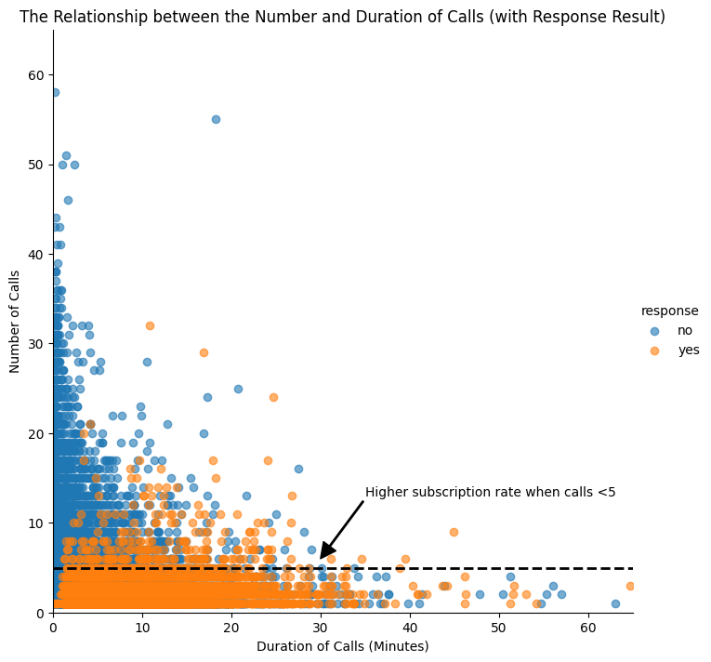
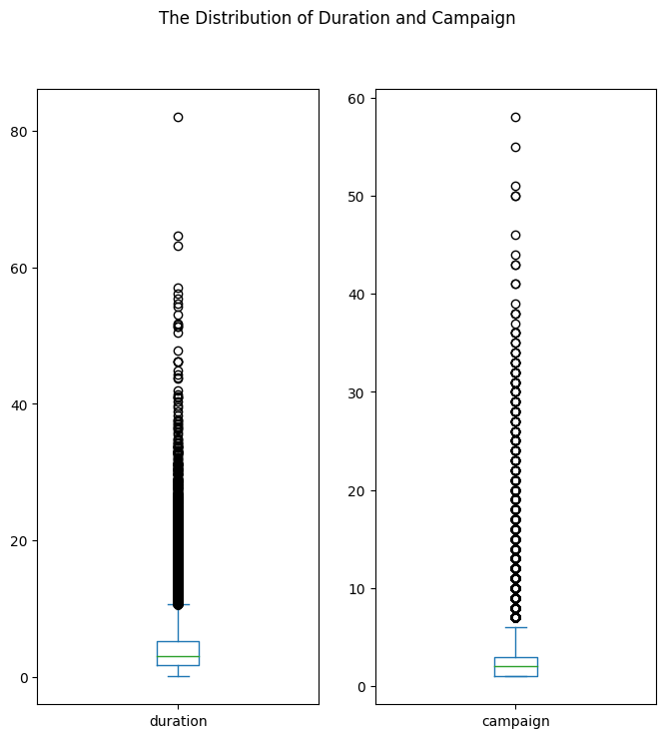
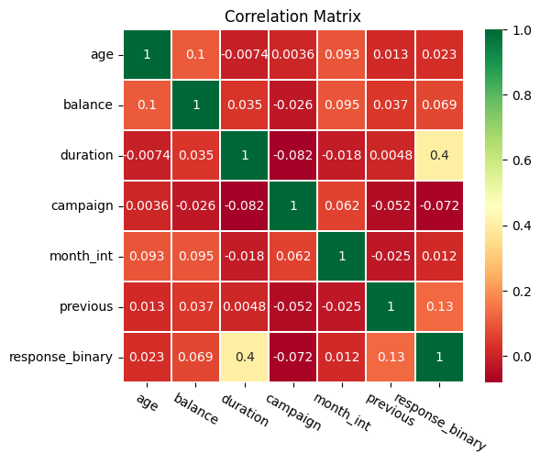
Distribution of Duration and Campaign:
Duration of Contact:
Median duration is 3 minutes, mostly short calls.
Left-skewed distribution with outliers (10 to 40 minutes).
Distribution of Campaign Contacts:
About half of clients contacted for the second time.
Normal distribution for most clients, but some contacted up to 58 times.
Relationship between Duration, Campaign, and Response:
Scatter Plot Analysis:
"Yes" clients contacted fewer times with longer durations.
Demarcation at around five campaign calls indicating rejection unless duration is high.
Scatter Matrix and Correlation Matrix:
Scatter Matrix:
No clear linear relationships among age, balance, duration, and campaign.
Correlation Matrix:
Strong positive correlation between "campaign outcome" and "duration."
Moderate correlation with "previous contacts."
Mild correlations with "balance," "month of contact," and "number of campaigns."

Slide 7
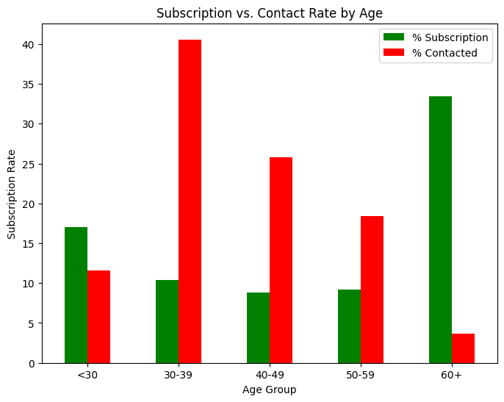
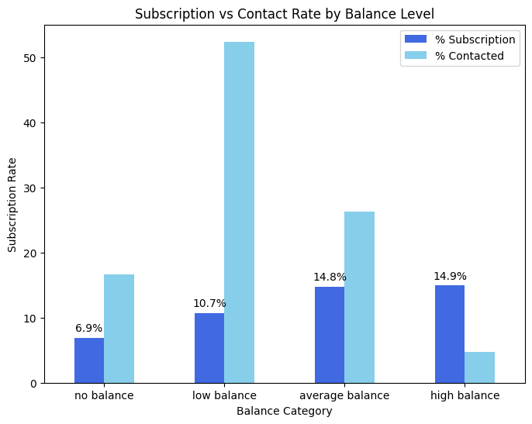
Data Visualization
Visualize the Subscription and Contact Rate by Age: In this visualization, you categorize clients into age groups and analyse the subscription and contact rates for each group. The key observations are:
Green vertical bars indicate that clients aged 60 and above have the highest subscription rate, at about 17%.
Approximately 17% of the subscriptions come from clients aged 18 to 29, showing the youngest age group is also quite receptive.
Red vertical bars indicate that the bank focused its marketing efforts on middle-aged clients, resulting in lower subscription rates compared to younger and older groups.
Recommendation: To make the marketing campaign more effective, it's suggested to target younger and older clients rather than focusing on the middle-aged group.
Visualize the Subscription Rate by Balance Level: In this visualization, clients are categorized based on their balance levels (no balance, low balance, average balance, high balance), and their subscription rates are examined. The key observations are:
Clients with negative balances (no balance) had a low subscription rate of 6.9%.
Clients with average or high balances exhibited significantly higher subscription rates, nearly 15%.
Recommendation: The bank should shift its marketing focus towards clients with average or high balances, as they have a much higher likelihood of subscribing to term deposits.

Slide 8
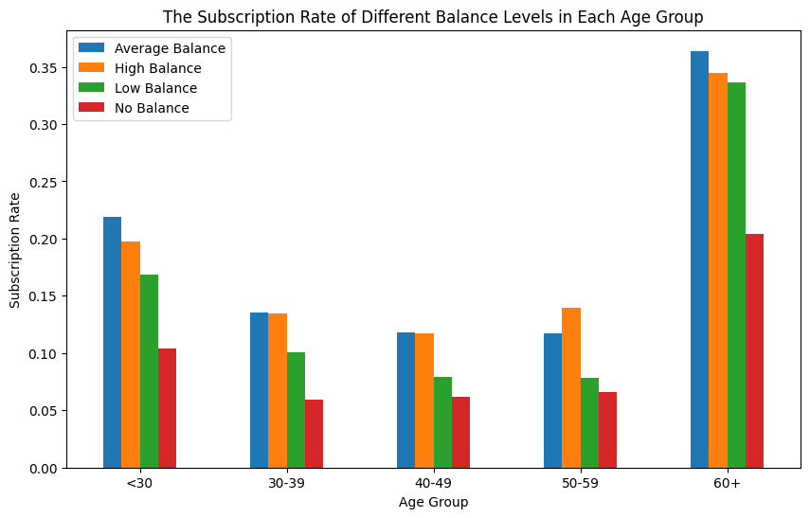
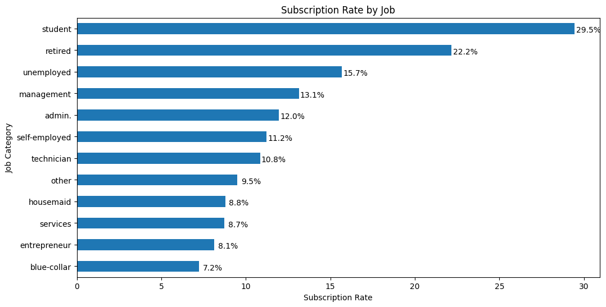
Data Visualizations
Visualize the Subscription Rate by Age and Balance: This visualization explores the combined impact of age and balance on the subscription rate. Key observations include:
Clients aged above 60 and clients below 30 have the highest subscription rates.
All age groups share a common trend: subscription rates increase with higher balance levels.
Recommendation: The bank should prioritize telemarketing for clients above 60 years old with positive balances and young clients with positive balances, as they have the highest subscription rates.
Visualize the Subscription Rate by Job: In this visualization, the subscription rates are broken down by job categories. Key observations include:
Students and retired clients contribute to more than 50% of subscriptions, which aligns with higher subscription rates among younger and older clients.
Recommendation: The bank should focus on targeting students and retired clients in their marketing efforts.

Slide 9
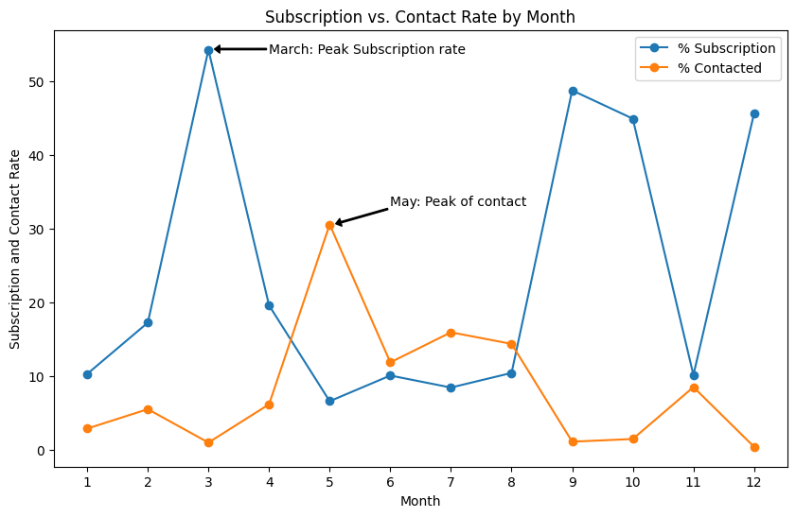
Visualize the Subscription and Contact Rate by Month:
This visualization explores the subscription and contact rates by month. Key observations are:
The bank contacted the most clients between May and August.
The highest contact rate occurred in May.
However, the highest subscription rate occurred in March, with rates over 50%.
The fall and spring months (September, October, and December) showed high subscription rates.
Recommendation: The bank should consider initiating telemarketing campaigns in the fall or spring, when the subscription rate tends to be higher. This may be more effective in converting contacts into subscriptions.

Slide 10
Data Preprocessing and Feature Engineering
Data Cleaning
Data Transformation :
Encoding Categorical Variables:
Utilized one-hot encoding for categorical variables.
Implementation using Pandas' get_dummies function.
Purpose: Convert categories into binary values (0 or 1) for each category.
Insights: Effective distinction between categories without introducing unintended ordinality.
Findings: Care needed to avoid overloading the model with too many variables.
Feature Scaling:
Applied feature scaling to numeric features.
Techniques: Standardization (Z-score scaling) or min-max scaling.
Code Explanation: Functions like StandardScaler or MinMaxScaler from Scikit-Learn.
Insights: Ensured equal treatment of all features, preventing dominance of any single feature.
Findings: Choice of scaling method should align with dataset characteristics and modeling algorithm.
Handling Imbalanced Data:
Addressed class imbalance using random undersampling.
RandomUnderSampler from the imblearn library with a 'auto' sampling strategy.
Insights: Improved model's ability to predict minority class instances, preventing bias.
Findings: Choice between oversampling and undersampling should align with dataset and modeling goals.

Slide 11
Feature engineering
Feature Engineering
Feature Selection:
Feature selection was performed without specifying the exact methods.
It involves evaluating feature importance using criteria like statistical tests, feature importance scores, or domain knowledge.
Code Explanation: The code for feature selection varies based on the specific method used, such as Recursive Feature Elimination (RFE) or feature importance scores.
Insights: Feature selection is an iterative process that leads to a simpler, more interpretable model.
Findings: Detailed documentation of feature selection is essential for transparency and model replicability.
Data Splitting
Data Split into Training and Testing Sets:
The dataset was divided into training and testing sets using an 80% training and 20% testing split ratio.
A random seed was specified for reproducibility.
Code Explanation: Data splitting was achieved using functions like train_test_split from libraries like Scikit-Learn.
Insights: Data splitting allowed us to evaluate the model's performance on unseen data, providing insights into its generalization capabilities.
Findings: The specific data split ratio may vary based on the dataset and modeling requirements.

Slide 12
Modelling
Classification Model
Classification Model: Gradient Boosting Classifier
Model Description
The chosen classification model for this project is the Gradient Boosting Classifier (GB). Gradient Boosting is an ensemble learning method that builds a strong predictive model by combining the predictions of multiple weaker models, often decision trees. This classifier is designed to predict whether a client will subscribe to a term deposit based on their information.
Feature Selection
Prior to modeling, a careful selection of features was undertaken. The selected features for the classifier include age, job, education, default, balance, housing, and loan. This selection was made considering the potential impact of these features on subscription decisions.
Data Preprocessing
To ensure data quality, preprocessing was performed. Missing values were handled appropriately, and categorical variables were transformed into dummy variables. Additionally, data balancing was executed to mitigate potential class imbalance issues.

Slide 13
Gradient Boosting Classifier
Model Approach and Strategy
Gradient Boosting Algorithm
Ensemble Learning: Gradient Boosting is an ensemble learning technique that combines the strengths of multiple decision trees, allowing the model to learn complex patterns in the data effectively.
Sequential Training: Weak models, typically decision trees, are trained sequentially. Each subsequent tree corrects the errors of the previous one, leading to a stronger overall model.
Gradient Descent Optimization: GB minimizes the loss function of the model by adjusting the weights of individual learners. This optimization process results in a more accurate classification model.
Model Evaluation and Selection
The selection of Gradient Boosting was based on several factors:
Ensemble Learning Capability: GB is chosen for its ability to handle complex relationships and nonlinearities in the data, which are often present in real-world scenarios.
Performance: Extensive experimentation with various algorithms and hyperparameters demonstrated that GB achieved the best performance, as measured by multiple evaluation metrics.

Slide 14
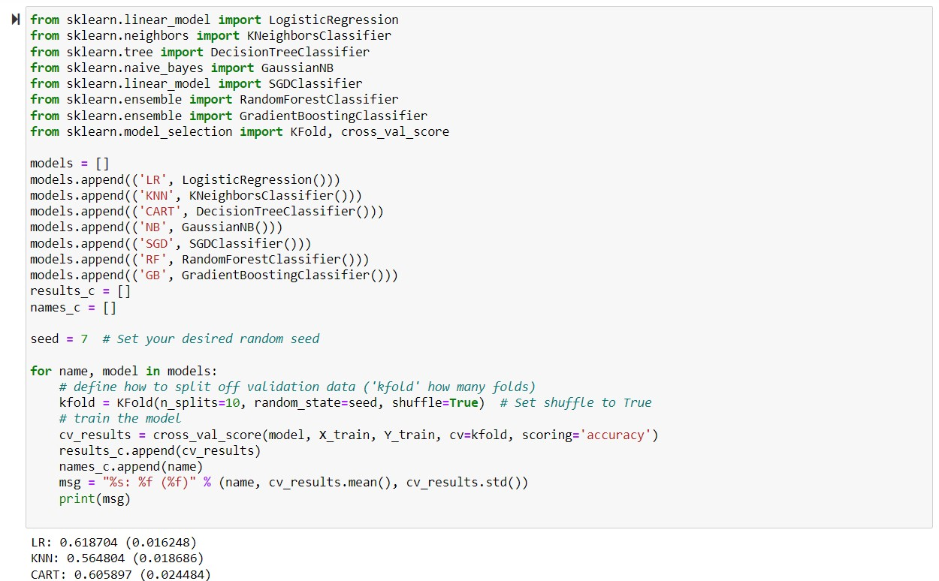
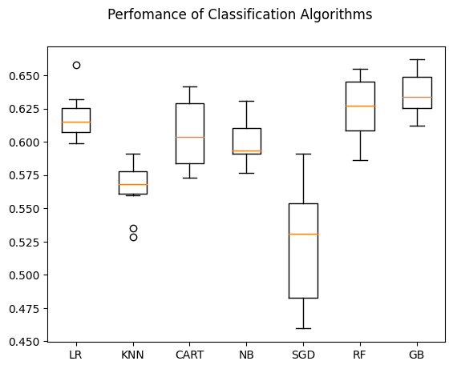
Model Evaluation
Model Evaluation:
We use k-fold cross-validation to evaluate and compare the performance of these models. The models are evaluated using accuracy as the scoring metric. Here are the results:
Logistic Regression (LR): Accuracy - 0.619
K-nearest neighbors (KNN): Accuracy - 0.565
Decision Tree (CART): Accuracy - 0.606
Gaussian Naive Bayes (NB): Accuracy - 0.599
Stochastic Gradient Descent (SGD): Accuracy - 0.520
Random Forest (RF): Accuracy - 0.624
Gradient Boosting Classifier (GB): Accuracy - 0.636
The Gradient Boosting Classifier (GB) demonstrates the highest accuracy, making it the most promising choice for further optimization.
After a comprehensive evaluation, the choice of Gradient Boosting as the primary classifier was driven by its superior accuracy and ability to capture complex relationships within the data. However, the decision should also consider project-specific goals and requirements. While Gradient Boosting is chosen as the primary classifier, the other algorithms may be valuable in different contexts.

Slide 15
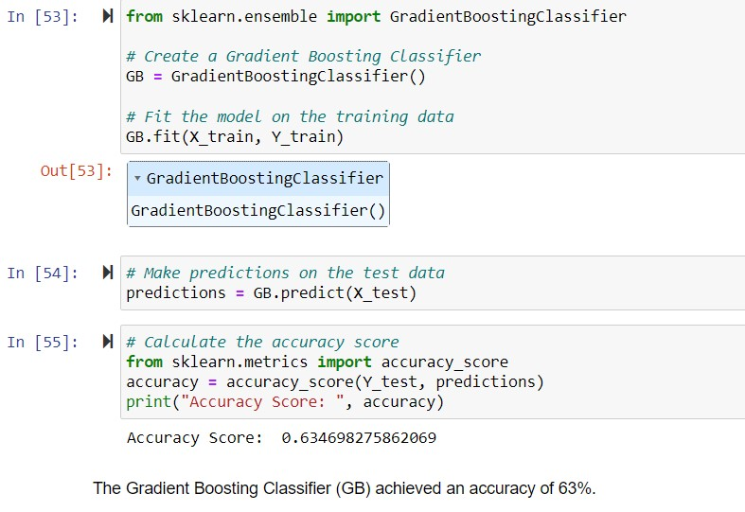
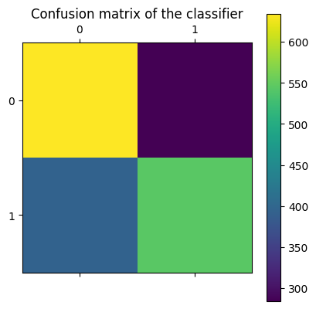
Confusion Matrix
A confusion matrix is a crucial tool for understanding the model's performance in binary classification tasks. It provides a detailed breakdown of correct and incorrect predictions.
The GB model's confusion matrix is as follows:
True Negatives (TN): 634 instances - correctly predicted clients who wouldn't subscribe.
False Positives (FP): 284 instances - incorrectly predicted subscriptions.
False Negatives (FN): 394 instances - incorrectly predicted declines.
True Positives (TP): 544 instances - correctly predicted subscriptions.
The dataset is well-balanced, with a nearly equal distribution of classes, which minimizes the impact of class imbalance on model performance.

Slide 16
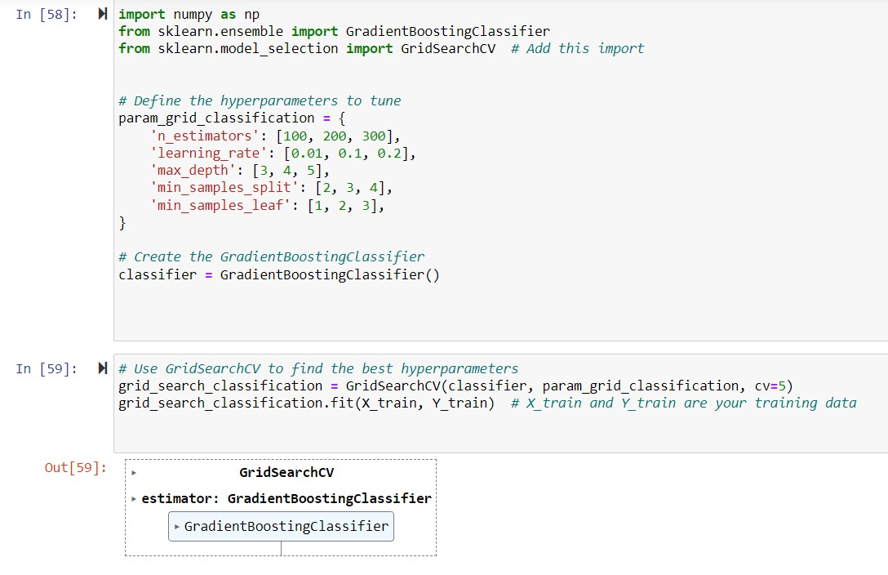
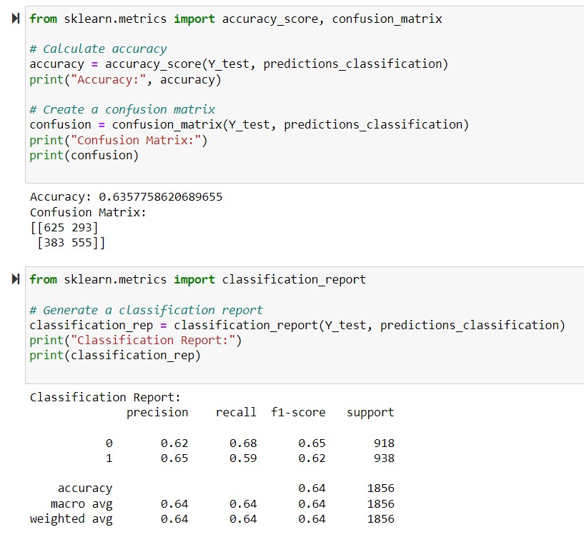
Hyperparameter Tunning
The best hyperparameters found through GridSearchCV are as follows:
Learning Rate: 0.1
Max Depth: 5
Min Samples Leaf: 2
Min Samples Split: 3
Number of Estimators: 100
After applying these hyperparameters, the accuracy of the GB model improved to approximately 63.6%. The confusion matrix and classification report demonstrate that hyperparameter tuning slightly enhanced the model's ability to classify client responses.
By using the hyperparameter tuning, the accuracy of the Gradient Boosting Classifier (GB) improved to approximately 64%. The confusion matrix and classification report demonstrate the model's performance with the tuned hyperparameters. The hyperparameter tuning resulted in a slight improvement in accuracy, indicating that the model is better at classifying clients' responses.

Slide 17
Conclusion
The Gradient Boosting Classifier excels in predicting whether clients will subscribe to a service, with an accuracy of approximately 63%. It outperforms six other classification algorithms, making it a strong candidate for making business decisions and shaping marketing strategies.
Precision and recall metrics help us understand the model's performance. Precision measures the proportion of accurate positive predictions, while recall gauges the model's ability to capture true positives while minimizing false positives. This balance ensures effective predictions without compromising reliability.
The model demonstrates balanced precision and recall for both subscriber and non-subscriber classes, making it versatile for marketing campaigns targeting both segments.
To further enhance the model's performance, hyperparameter tuning has been performed, resulting in a marginal accuracy improvement to approximately 63.6%. While this classification model is already useful, additional improvements could be achieved by gathering more data, refining feature engineering, or exploring advanced machine learning techniques.
In summary, the Gradient Boosting Classifier offers a reliable solution for predicting client behavior. Its versatility, moderate accuracy, and potential for further improvement make it a valuable asset for businesses seeking to make data-driven decisions and optimize marketing strategies

Slide 18
Regression Model
Regression analysis plays a crucial role in enhancing the predictive capabilities of the bank by providing a complementary approach to the classification results. In this specific task, the primary objective is to estimate the duration of a phone call, a variable strongly correlated with campaign outcomes. By using regression algorithms, the bank can gain insights into the likely duration of a call, which, in turn, aids in predicting the subscription rate more accurately.
Prepare Data for Regression
Feature Selection- The process of feature selection involves identifying and extracting specific customer statistics that can be used as predictors for estimating the duration of phone calls. The model aims to leverage these features to make precise predictions about the 'duration' variable.
Train/Test Split
Compare Regression Algorithms
This stage involves testing the dataset against six distinct regression algorithms:
Linear Regression
Lasso Regression
Ridge Regression
ElasticNet Regression
K Neighbors Regression
Decision Tree Regression
The aim here is to identify which algorithm performs best in estimating the duration of phone calls. This "best-performing" algorithm will be selected to build the duration estimation model.

Slide 19
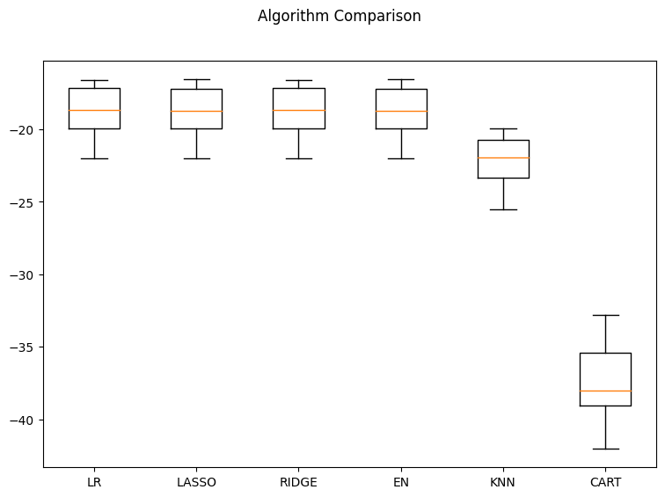
Ridge Regression Model
Results of Regression Algorithms
The evaluation of these algorithms is carried out using a k-fold cross-validation approach with 10 folds. The performance metric used is the mean squared error (MSE), which measures how closely the predicted values align with the actual values. Here are the results for each regression algorithm:
Linear Regression: MSE ≈ 18.66
Lasso Regression: MSE ≈ 18.70
Ridge Regression: MSE ≈ 18.66
ElasticNet Regression: MSE ≈ 18.70
K Neighbors Regression: MSE ≈ 22.10
Decision Tree Regression: MSE ≈ 37.48
From these results, it's evident that Ridge regression stands out slightly ahead of the others, boasting the lowest MSE.

Slide 20
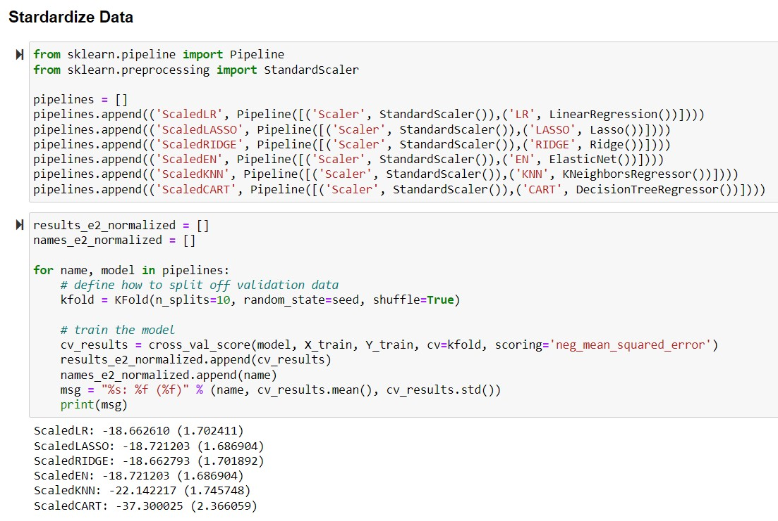
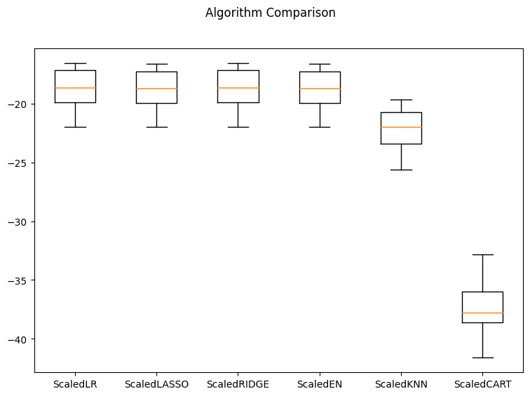
Standerdize Data
To ensure that the models are performing on an even playing field, data standardization is performed using the StandardScaler. This step involves scaling all features to have a consistent scale. Standardization can significantly improve the performance of some machine learning models.
Results of Standardized Regression Algorithms
Following the standardization process, the regression models are re-evaluated, producing the following results:
Scaled Linear Regression: MSE ≈ 18.66
Scaled Lasso Regression: MSE ≈ 18.72
Scaled Ridge Regression: MSE ≈ 18.66
Scaled ElasticNet Regression: MSE ≈ 18.72
Scaled K Neighbors Regression: MSE ≈ 22.14
Scaled Decision Tree Regression: MSE ≈ 37.30
Surprisingly, even after standardization, Ridge regression maintains its leading position with the lowest MSE, which highlights its robustness and predictive capabilities.

Slide 21
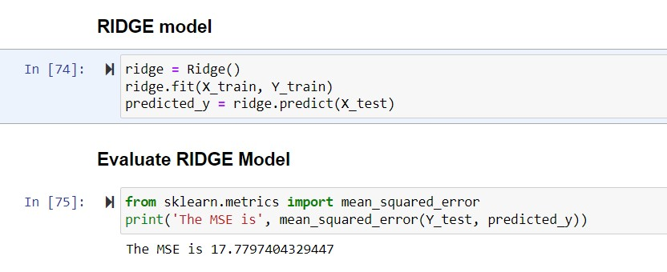
Evaluate Model
In this final stage of the analysis, the Ridge regression model is assessed on the test set. The evaluation reveals an MSE of approximately 17.78. The magnitude of this MSE reflects the quality of predictions, with lower values signifying that the model's predictions are closer to the actual duration values.
Notably, this dataset contains phone call durations that range from 0.1 to 81.97 minutes, indicating substantial variability. The resulting MSE of 17.78 is a strong indication of Ridge regression's effectiveness in estimating the 'duration' variable, even within this wide range. This achievement means that the bank can confidently estimate the duration of campaign calls for each client using their respective customer profiles. Such profiles include attributes like age, job, and loan status.
In conclusion, Ridge regression emerges as the optimal choice for estimating the duration of phone calls, offering a valuable tool for the bank to predict subscription rates based on customer statistics. The relatively low MSE on the test set signifies the model's effectiveness and its potential to enhance campaign planning and decision-making processes.
According to the previous analysis, observations on duration are extremely varied from 0.1 to 81.97 minutes in this dataset. Therefore, a 17.78 MSE testifies that ridge regression is a sound model in predicting the target variable and suggests that the bank can roughly estimate the duration of campaign calls of each client using their customer profiles such as age, job, and loans.

Slide 22
Conclusion
The main objective of this project is to increase the effectiveness of the bank's telemarketing campaign, which was successfully met through data analysis, visualization and analytical model building. A target customer profile was established while classification and regression models were built to predict customers' response to the term deposit campaign.
The primary objective of this project is to enhance the efficiency and effectiveness of the bank's telemarketing campaign. The key outcomes are:
Target Customer Profile
A well-defined target customer profile has been established. The customers most likely to respond positively to the term deposit campaign exhibit the following characteristics:
Age Segmentation: They are either young (age < 30) or senior (age > 60) individuals.
Life Stage: They are students or retired individuals.
Strong Financial Position: They maintain a bank account balance of more than 5000 euros.
Models for Response Prediction
To effectively identify and allocate marketing efforts, two key models have been developed:
Classification Model: A combination of Gradient boosting and ridge regression algorithms has been successfully used to build a classification model. This model predicts whether a customer is likely to accept a term deposit or not. It enables the bank to direct its marketing efforts more efficiently, allocating resources to clients who are highly likely to accept term deposits and reducing calls to those who are unlikely to do so.
Regression Model: This model, developed using ridge regression, helps predict the expected duration of a call before it is made. By predicting the duration, the bank can optimize its marketing plan, benefiting both the bank and its clients. It leads to a more efficient telemarketing campaign, saving time and effort for both parties, and preventing clients from receiving unwanted advertisements, which, in turn, enhances customer satisfaction.

Slide 23
Recommendation
To further enhance the effectiveness of the telemarketing campaign, the following recommendations are suggested:
Timing Considerations: When executing marketing strategies, the timing of the campaign should be thoughtfully considered. The analysis has indicated that March, September, October, and December have the highest success rates. However, it's essential to gather more data and conduct ongoing analysis to ensure that this seasonal effect persists over time. If this trend is consistent, the bank should plan its telemarketing campaign during the fall and spring seasons to maximize its impact.
Smarter Marketing Design: By focusing on the right customers as identified by the classification models, the bank can expect more positive responses. Over time, this is likely to reduce the imbalance in the original dataset. To increase the likelihood of subscription, the bank should also re-evaluate the content and design of its current campaign, making it more appealing and relevant to the target customers. A well-designed and targeted campaign will enhance customer engagement and subscription rates.
Better Service Provision: With a more granular understanding of its customer base, the bank can provide tailored banking services. For example, insights into marital status and occupation provide a glimpse into a customer's life stage, while loan status indicates their overall risk profile. Armed with this information, the bank can anticipate when a customer might be interested in making an investment. By offering the right banking services to the right customers at the right time, the bank can better satisfy customer demands, thus enhancing customer loyalty and long-term relationships.
In summary, the combination of predictive models and data-driven insights equips the bank with the tools and knowledge to optimize its telemarketing campaigns. By following these recommendations, the bank can further improve its marketing strategies, target the right customers, and provide enhanced services, ultimately leading to a more successful and efficient telemarketing campaign while ensuring customer satisfaction and loyalty.

Slide 24


